Slide 1
Automated Pneumonia Detection from Chest X-Ray Images using Deep Learning
Name: RAJIB ROY
Department: AI
SR NUMBER:24459

Slide 2
PROBLEM STATEMENT
Clinical Motivation: Pneumonia is a leading cause of mortality in children worldwide. Manual diagnosis from chest X-rays is time-consuming and prone to inter-observer variability.
Primary Objective:
Develop a deep learning–based model to classify chest X-ray images as Pneumonia or Normal.
Secondary Objectives:
Compare performance of multiple pretrained CNN architectures
Address class imbalance using data augmentation
Apply Grad-CAM to improve clinical interpretability

Slide 3
DATASETS TO BE USED
Dataset Name & Size: Kaggle Chest X-Ray Pneumonia Dataset - 5,863 labelled chest X-ray images
Patient Demographics: Pediatric patients (approx. 1–5 years)
Imaging Details: Posterior–Anterior (PA) chest X-ray images
Annotations:
Image-level labels (Normal / Pneumonia)
Annotated by expert radiologists
Additional Notes: Public benchmark dataset widely used in medical AI research

Slide 4
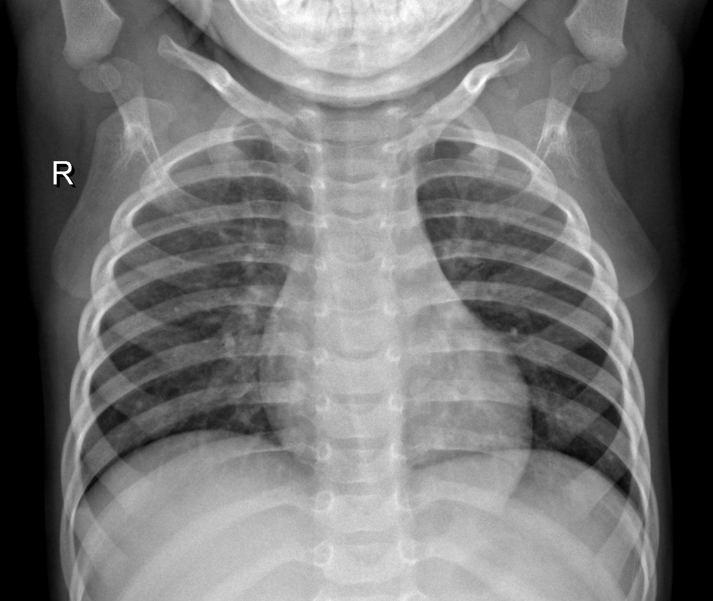
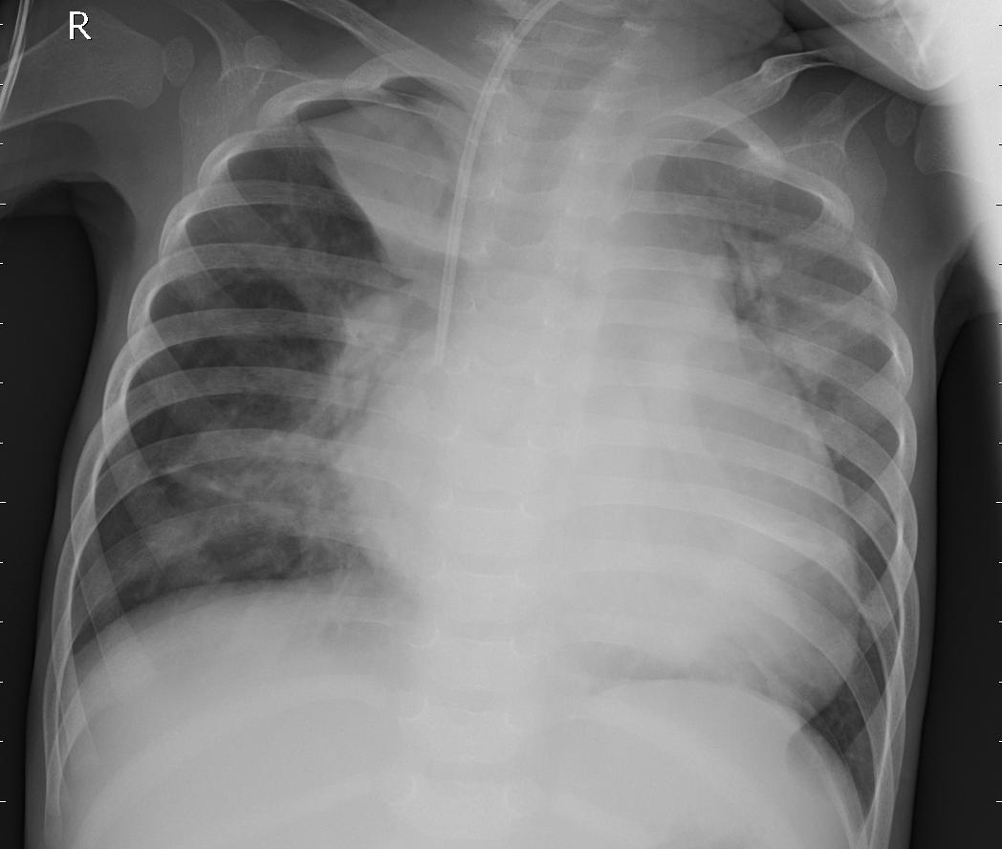
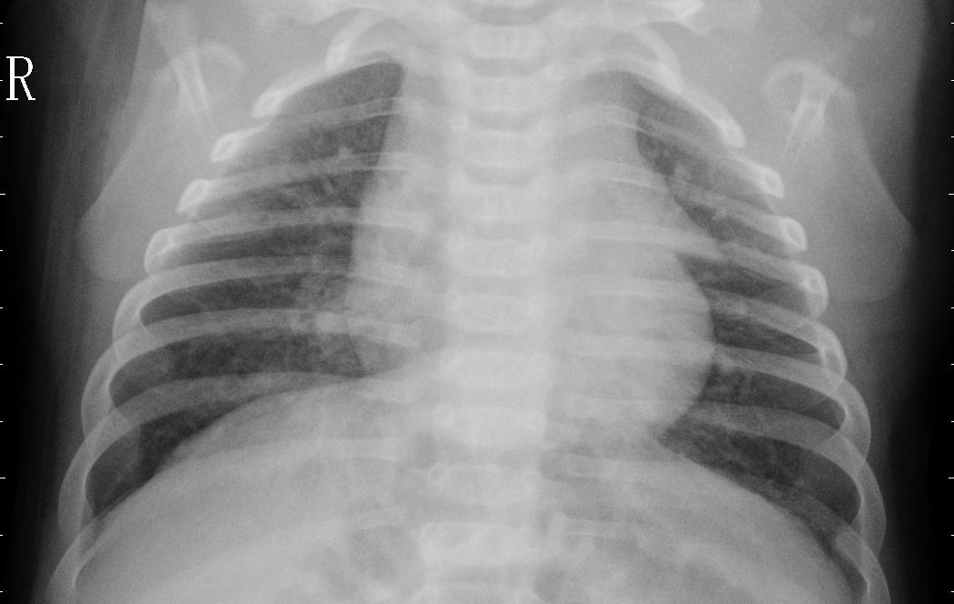
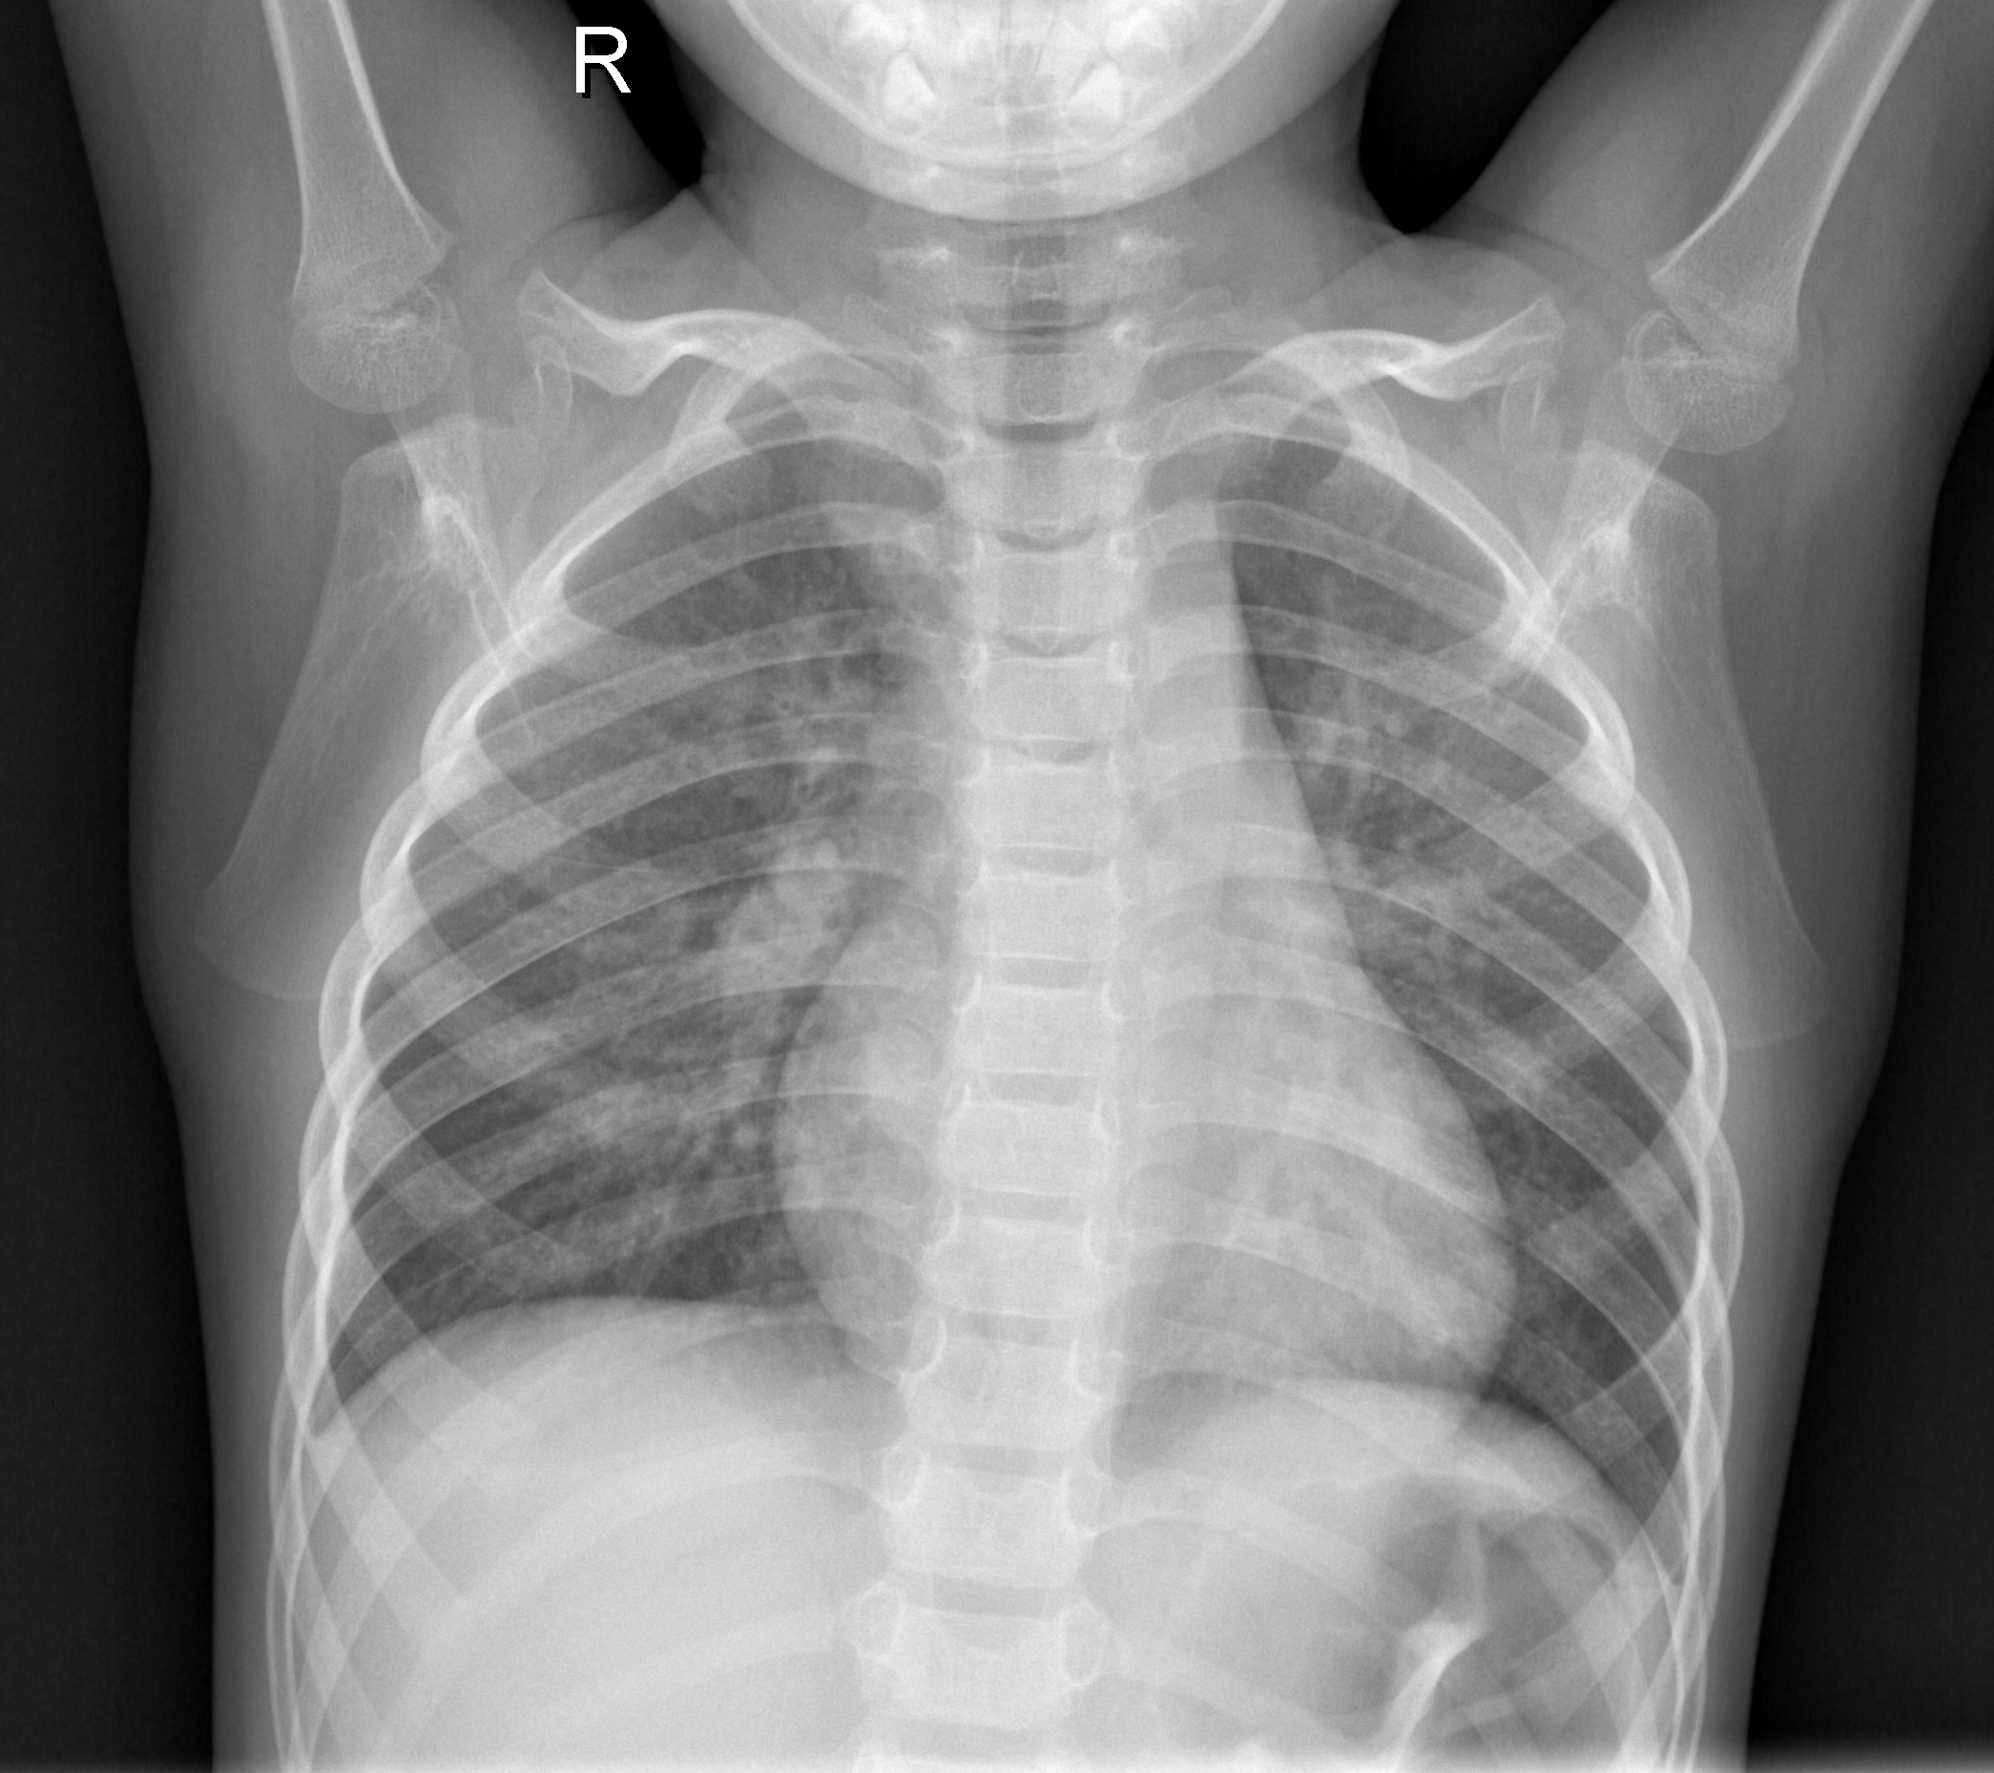
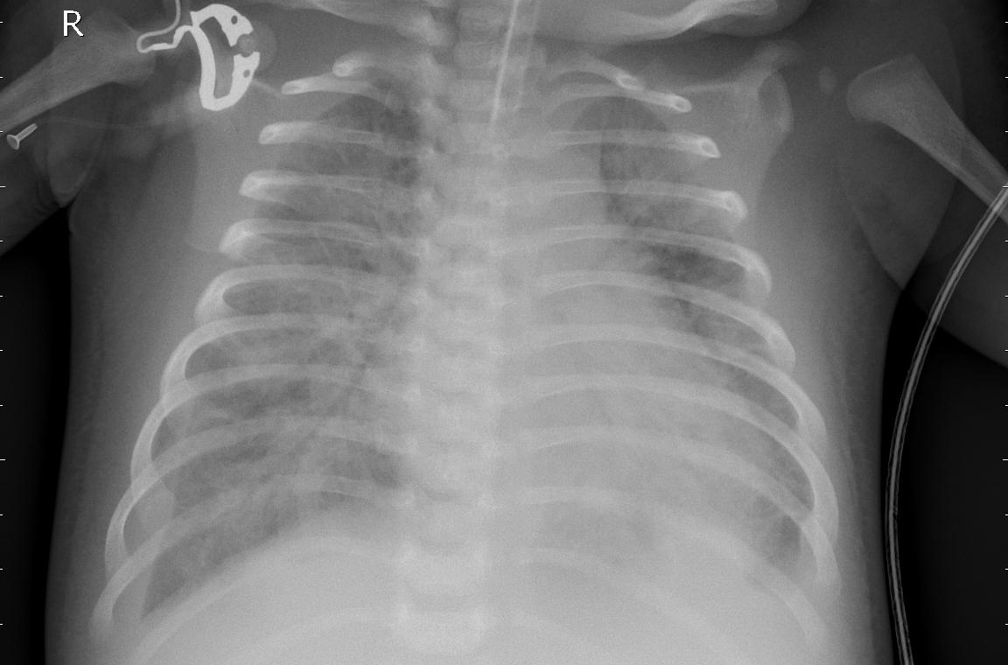
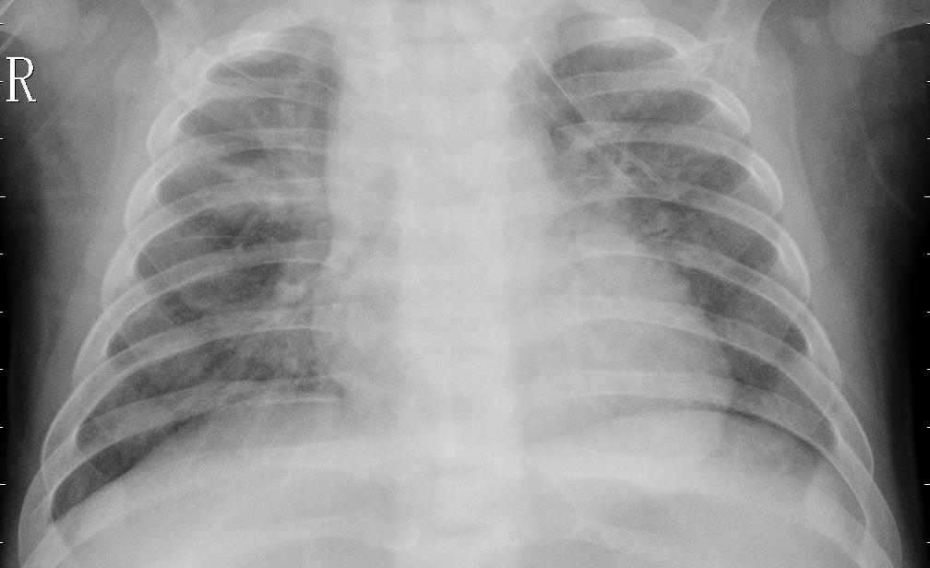
SAMPLE IMAGES The normal chest X-ray (left panel) depicts clear lungs without any areas of abnormal opacification in the image. Bacterial pneumonia (middle) typically exhibits a focal lobar consolidation, whereas viral pneumonia (right) manifests with a more diffuse ‘‘interstitial’’ pattern in both lungs.
NORMAL
BACTERIA INFECTED
VIRUS INFECTED

Slide 5
BASELINE PAPER(S) TO START
Paper: Rajpurkar et al., CheXNet: Radiologist-Level Pneumonia Detection on Chest X-Rays (2017)
Why This Paper?
Landmark study proving CNNs can achieve radiologist-level performance
Uses DenseNet-121 architecture
Key Contributions:
Introduced deep DenseNet architecture for chest X-ray analysis
Established DL as a clinical decision-support tool
Performance:
AUROC ≈ 0.76 for pneumonia detection

Slide 6
BASELINE PAPER(S) TO START
Paper: Irvin et al., CheXpert: A Large Chest Radiograph Dataset with Uncertainty Labels (AAAI 2019)
Why This Paper?
Addresses label uncertainty in medical imaging
Improves robustness and generalization
Key Contributions:
Introduced uncertainty-aware labelling
Proposed clinically realistic evaluation strategies
Performance:
AUROC ≈ 0.80–0.85 (model-dependent)

Slide 7
METHODOLOGY AND EVALUATION
Pipeline:
Data preprocessing & augmentation
Train baseline CNN model
Handle class imbalance
Compare multiple CNN architectures
Evaluate using standard metrics
Apply Grad-CAM for explainability
Evaluation Metrics Used:
Accuracy
Area Under ROC Curve (AUROC)
Sensitivity (Recall)
Specificity
Confusion Matrix

Slide 8
TASKS
Data & Evaluation
Dataset understanding and EDA
Data preprocessing & augmentation
Handling class imbalance
Model evaluation & metrics analysis
Confusion matrix, ROC curves
Modeling & Architecture
CNN model implementation
Transfer learning with pretrained models
Architecture comparison (DenseNet, ResNet, etc.)
Hyperparameter tuning
Grad-CAM implementation & visualization
Deliverables
Literature review
Result interpretation and documentation
Final conclusions

